Slide 1



$$y$$
$$i$$
$$x$$

Slide 2
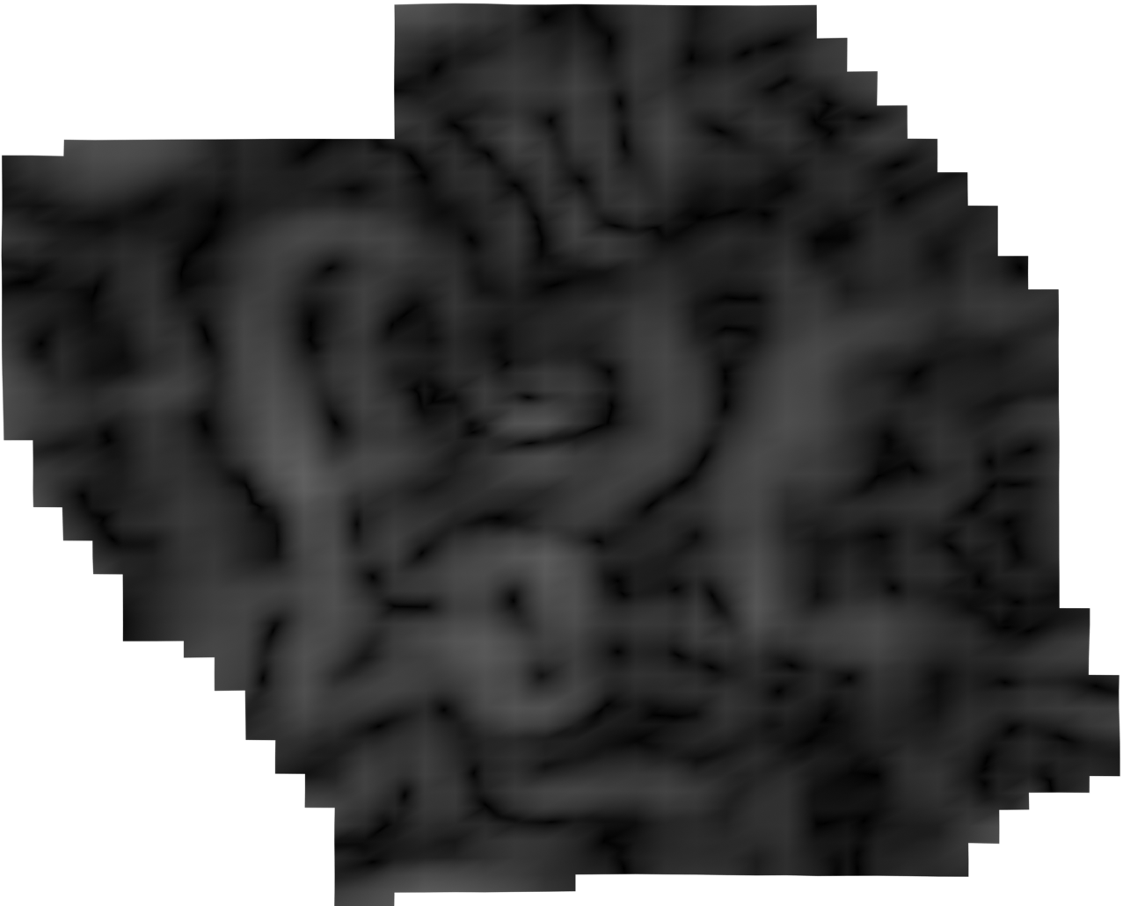
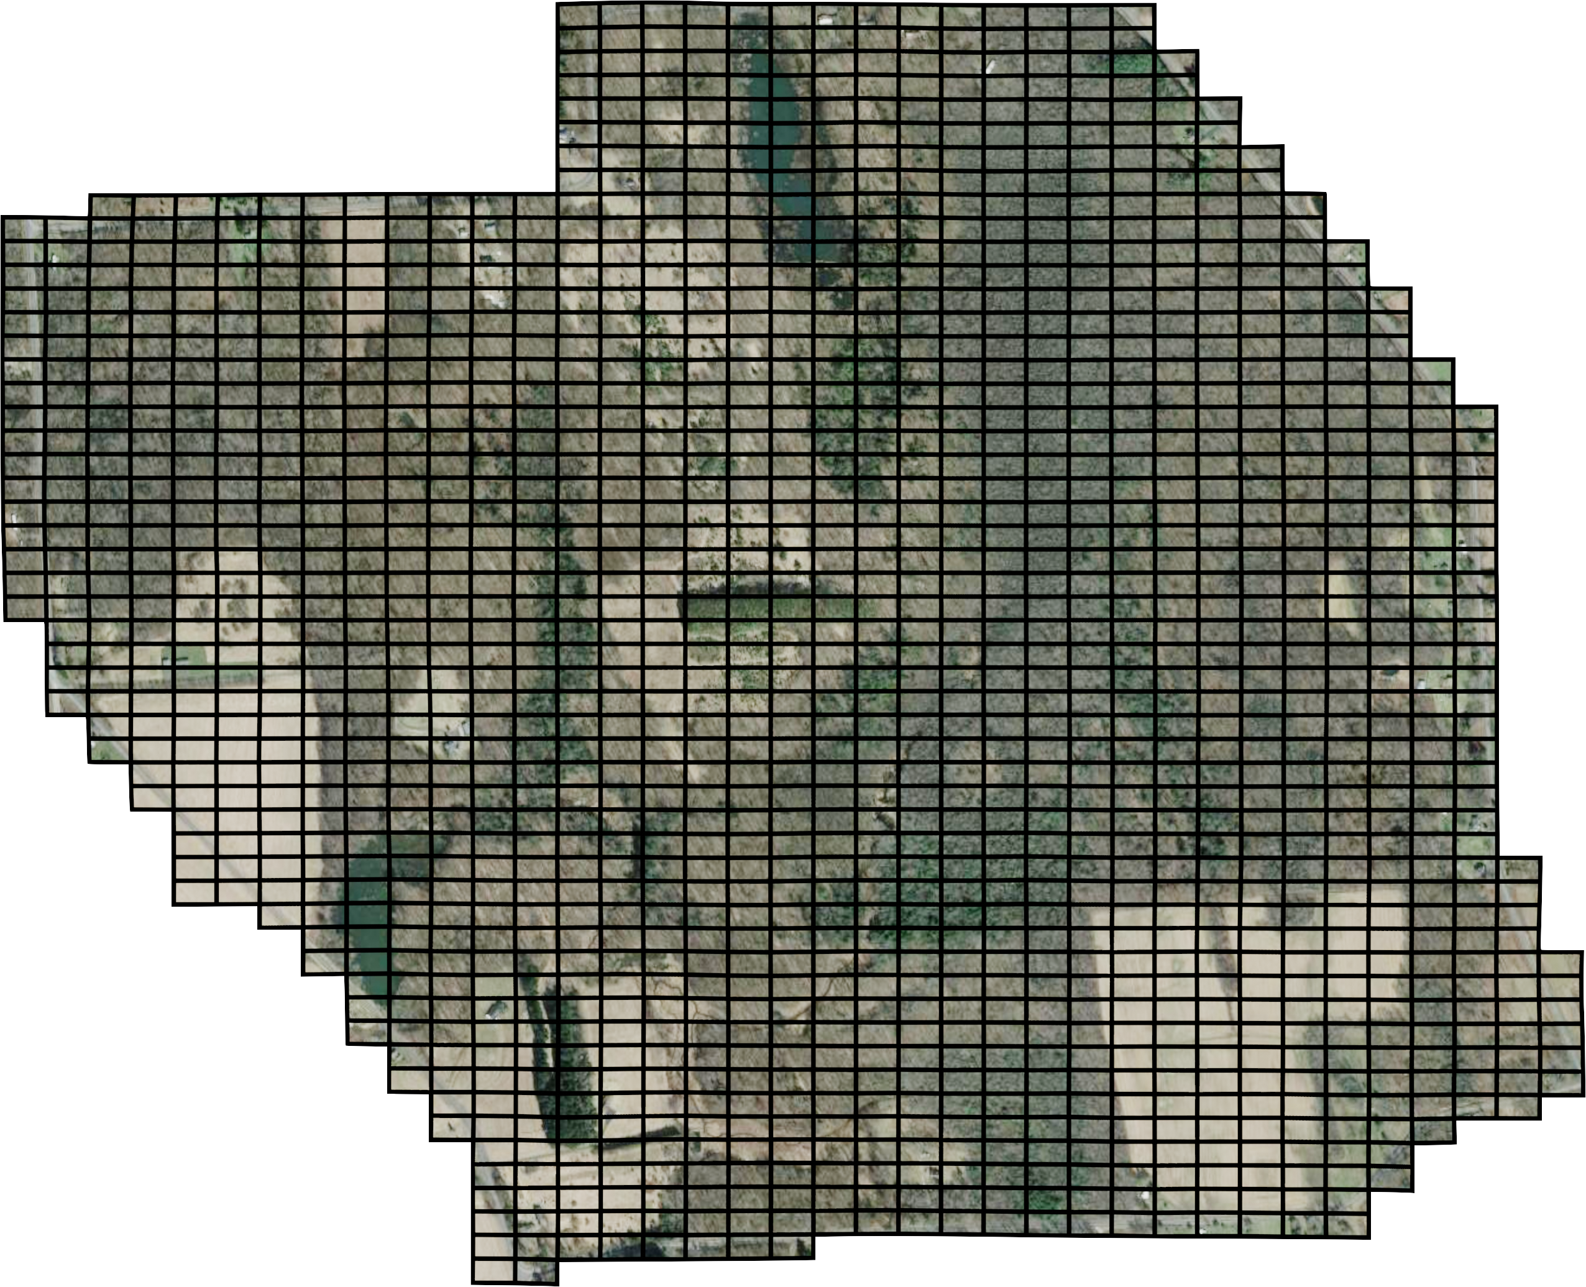
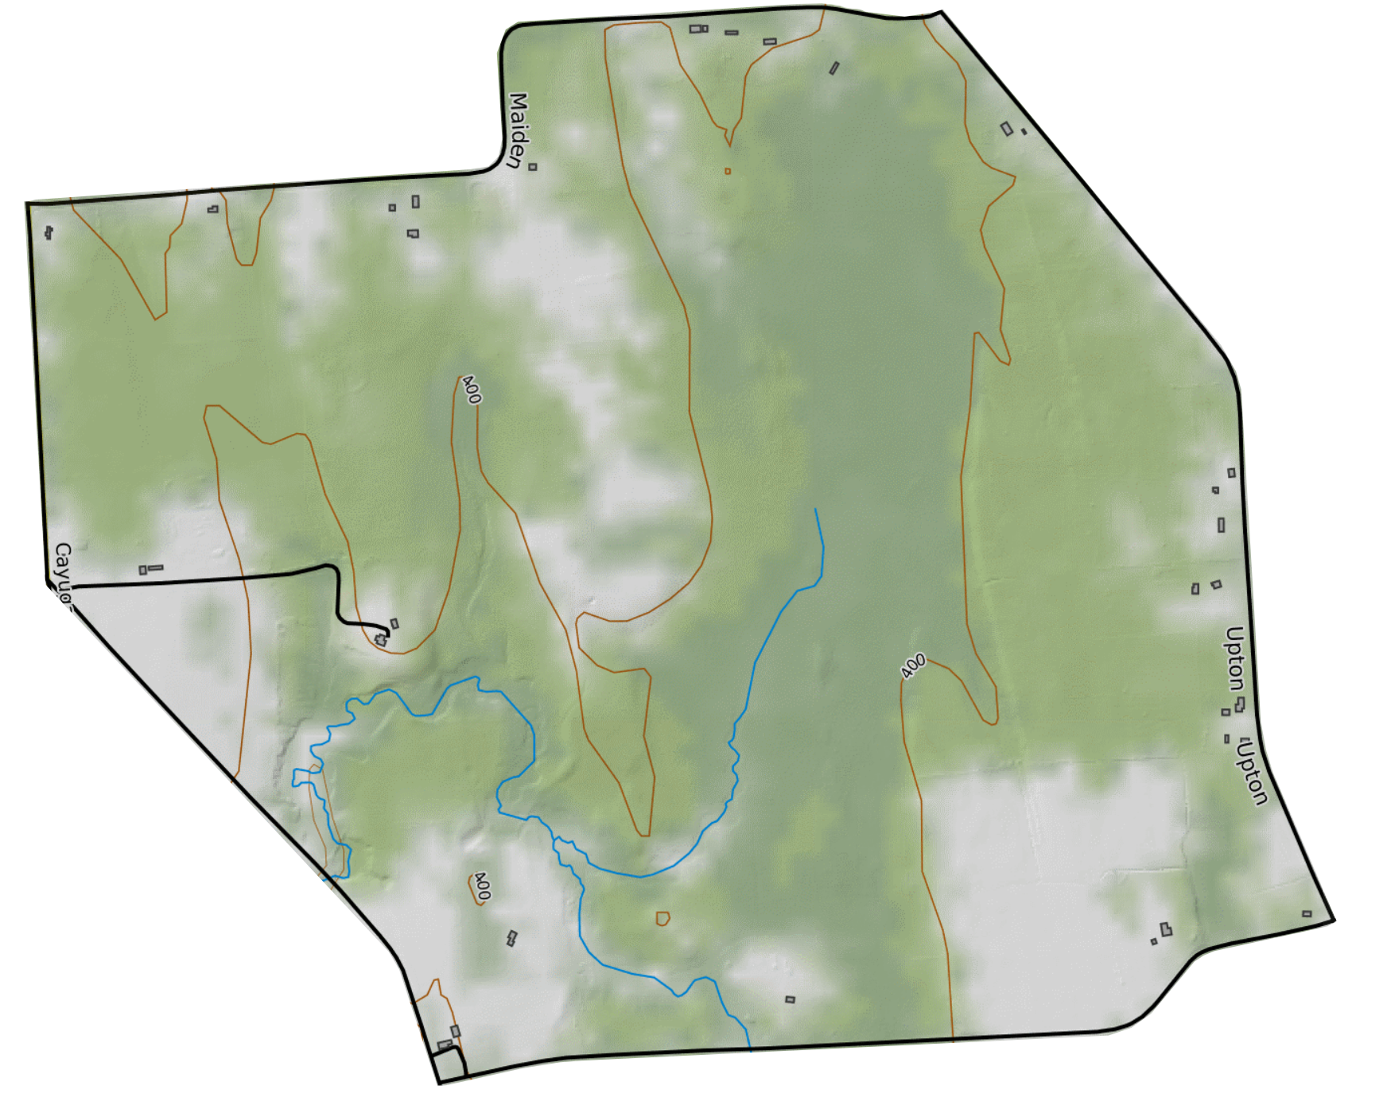


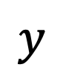
$$y$$
$$i$$
$$x$$

Slide 3
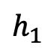

$$h_{1}$$
$$t$$

Slide 4
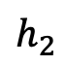
$$h_{2}$$
$$t$$

Slide 5
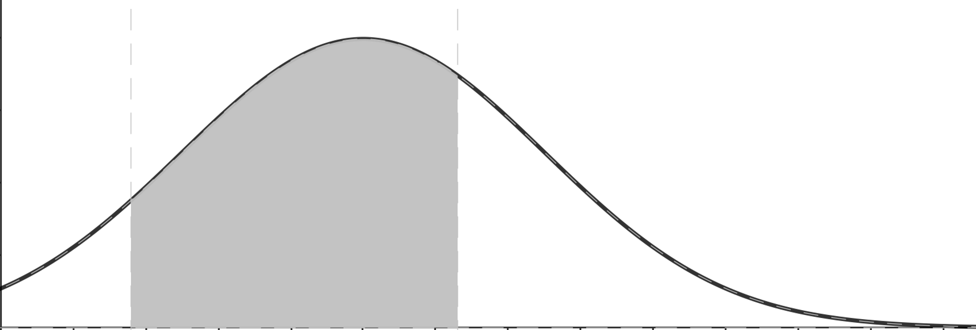
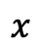
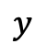
$$y$$
$$x$$

Slide 6
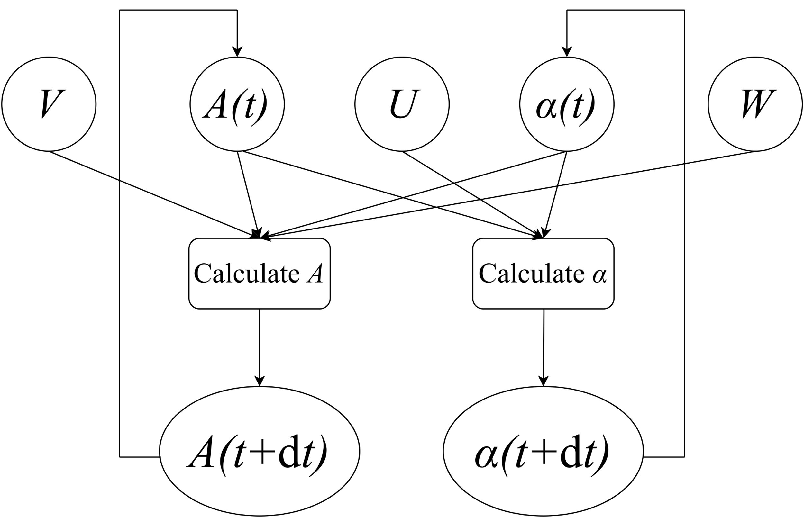

Slide 7
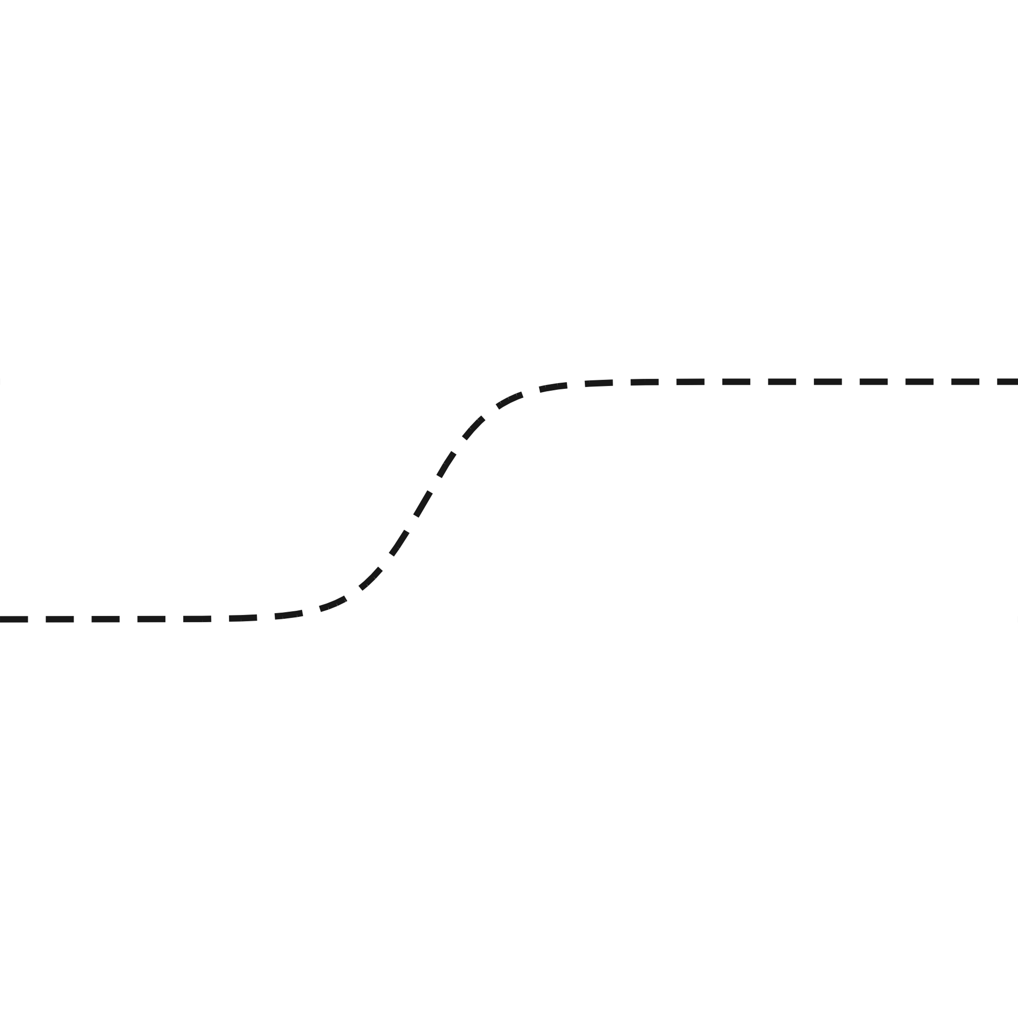
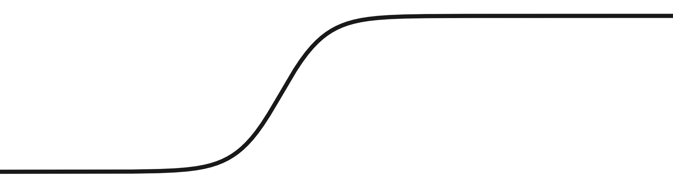

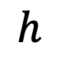
$$h$$
$$t$$

Slide 9
 |  |  |  |  |  |  |  |  |  |  |  |  | 0 | 0 | 0 | 0 | 0 | 0 | 0 | 0 | 0 | 0 | 0 | 0 | 0 | 0
 |  |  |  |  |  |  |  |  |  |  |  |  | 0 | 0 | 0 | 0 | 0 | 0 | 0 | 0 | 0 | 0 | 0 | 0 | 0 | 0
 |  |  |  |  |  |  |  |  |  |  |  |  | 0 | 0 | 0 | 0 | 0 | 0 | 0 | 0 | 0 | 0 | 0 | 0 | 0 | 0 | 0
 |  |  |  |  |  |  |  |  |  |  |  |  | 0 | 0 | 0 | 0 | 0 | 0 | 0 | 0 | 0 | 0 | 0 | 0 | 0 | 0 | 0
 |  |  |  |  |  |  |  |  |  |  |  |  | 0 | 0 | 0 | 0 | 0 | 0 | 0 | 0 | 0 | 0 | 0 | 0 | 0 | 0 | 0 | 0
 |  |  |  |  |  |  |  |  |  |  |  |  | 0 | 0 | 0 | 0 | 0 | 0 | 0 | 0 | 0 | 0 | 0 | 0 | 0 | 0 | 0 | 0
 |  |  |  |  |  |  |  |  |  |  |  |  | 3 | 0 | 0 | 0 | 0 | 0 | 0 | 0 | 0 | 0 | 0 | 0 | 0 | 0 | 0 | 0 | 0
 |  |  |  |  |  |  |  |  |  |  |  |  | 3 | 3 | 0 | 0 | 0 | 0 | 0 | 0 | 0 | 0 | 0 | 0 | 0 | 0 | 0 | 0 | 0
 |  | 0 | 0 | 0 | 0 | 0 | 0 | 3 | 0 | 0 | 0 | 0 | 0 | 0 | 0 | 0 | 0 | 0 | 0 | 0 | 0 | 0 | 0 | 0 | 0 | 0 | 0 | 0 | 0 | 0
3 | 0 | 0 | 0 | 0 | 0 | 0 | 0 | 3 | 0 | 0 | 0 | 0 | 0 | 0 | 0 | 0 | 0 | 0 | 0 | 0 | 0 | 0 | 0 | 0 | 0 | 0 | 0 | 0 | 0 | 0
3 | 0 | 0 | 0 | 0 | 0 | 0 | 0 | 3 | 0 | 0 | 0 | 0 | 0 | 3 | 3 | 0 | 0 | 0 | 0 | 0 | 0 | 0 | 0 | 0 | 0 | 0 | 0 | 0 | 0 | 0 | 0
3 | 0 | 0 | 0 | 0 | 0 | 0 | 0 | 3 | 0 | 0 | 0 | 0 | 0 | 3 | 3 | 3 | 0 | 0 | 0 | 0 | 0 | 0 | 0 | 0 | 0 | 0 | 0 | 0 | 0 | 0 | 0
3 | 0 | 0 | 0 | 0 | 0 | 0 | 0 | 0 | 0 | 0 | 0 | 0 | 0 | 3 | 3 | 3 | 0 | 0 | 0 | 0 | 0 | 0 | 0 | 0 | 0 | 0 | 0 | 0 | 0 | 0 | 0 | 0
3 | 0 | 0 | 0 | 0 | 0 | 0 | 0 | 0 | 0 | 0 | 0 | 0 | 0 | 0 | 3 | 3 | 0 | 0 | 0 | 0 | 0 | 0 | 0 | 0 | 0 | 0 | 0 | 0 | 0 | 0 | 0 | 0
3 | 0 | 0 | 0 | 0 | 0 | 0 | 0 | 0 | 0 | 0 | 0 | 0 | 0 | 0 | 0 | 3 | 3 | 0 | 0 | 0 | 0 | 0 | 0 | 0 | 0 | 0 | 0 | 0 | 0 | 0 | 0 | 0
3 | 0 | 0 | 0 | 0 | 0 | 0 | 0 | 0 | 0 | 0 | 0 | 0 | 0 | 0 | 0 | 0 | 0 | 0 | 0 | 0 | 0 | 0 | 0 | 0 | 0 | 0 | 0 | 0 | 0 | 0 | 0 | 0 | 0
3 | 0 | 0 | 0 | 0 | 0 | 0 | 0 | 0 | 0 | 0 | 0 | 0 | 0 | 0 | 0 | 0 | 0 | 0 | 0 | 0 | 0 | 0 | 0 | 0 | 0 | 0 | 0 | 0 | 0 | 0 | 0 | 0 | 0
3 | 0 | 0 | 0 | 0 | 0 | 0 | 0 | 0 | 0 | 0 | 0 | 0 | 0 | 0 | 0 | 3 | 0 | 0 | 0 | 0 | 0 | 0 | 0 | 0 | 0 | 0 | 0 | 0 | 0 | 0 | 0 | 0 | 0 | 0
3 | 0 | 0 | 0 | 0 | 0 | 0 | 0 | 0 | 0 | 0 | 0 | 0 | 0 | 0 | 0 | 0 | 0 | 0 | 0 | 0 | 0 | 0 | 0 | 0 | 0 | 0 | 0 | 0 | 0 | 0 | 0 | 0 | 0 | 0
3 | 0 | 0 | 0 | 0 | 0 | 0 | 0 | 0 | 0 | 0 | 0 | 0 | 0 | 0 | 0 | 0 | 0 | 0 | 0 | 0 | 0 | 0 | 0 | 0 | 0 | 0 | 0 | 0 | 0 | 0 | 0 | 0 | 0 | 0
3 | 0 | 0 | 0 | 0 | 0 | 0 | 0 | 0 | 0 | 0 | 0 | 0 | 0 | 0 | 0 | 0 | 0 | 0 | 0 | 0 | 0 | 0 | 0 | 0 | 0 | 0 | 0 | 0 | 0 | 0 | 0 | 0 | 0 | 0
3 | 0 | 0 | 0 | 0 | 0 | 0 | 0 | 0 | 0 | 0 | 0 | 0 | 0 | 0 | 0 | 0 | 0 | 0 | 0 | 0 | 0 | 0 | 0 | 0 | 0 | 0 | 0 | 0 | 0 | 0 | 0 | 0 | 0 | 0
3 | 3 | 0 | 0 | 0 | 0 | 0 | 0 | 0 | 0 | 0 | 0 | 0 | 0 | 0 | 0 | 0 | 0 | 0 | 0 | 0 | 0 | 0 | 0 | 0 | 0 | 0 | 0 | 0 | 0 | 0 | 0 | 0 | 0 | 0
3 | 3 | 0 | 0 | 0 | 3 | 0 | 0 | 0 | 0 | 0 | 0 | 0 | 0 | 0 | 0 | 0 | 0 | 0 | 0 | 0 | 0 | 0 | 0 | 0 | 0 | 0 | 0 | 0 | 0 | 0 | 0 | 0 | 0 | 0
3 | 3 | 0 | 0 | 0 | 3 | 0 | 0 | 0 | 0 | 0 | 0 | 0 | 0 | 0 | 3 | 0 | 0 | 0 | 0 | 0 | 0 | 0 | 0 | 0 | 0 | 0 | 0 | 0 | 0 | 0 | 0 | 0 | 0 | 0
3 | 3 | 0 | 3 | 0 | 3 | 3 | 0 | 3 | 0 | 0 | 0 | 0 | 0 | 0 | 3 | 0 | 0 | 0 | 0 | 0 | 0 | 0 | 0 | 0 | 0 | 0 | 0 | 0 | 0 | 0 | 0 | 0 | 0 | 0
 | 3 | 3 | 0 | 3 | 3 | 3 | 0 | 3 | 0 | 0 | 0 | 0 | 0 | 0 | 0 | 3 | 0 | 0 | 0 | 0 | 0 | 0 | 0 | 0 | 0 | 0 | 0 | 0 | 0 | 0 | 0 | 0 | 0 | 0
 | 3 | 3 | 3 | 3 | 3 | 3 | 0 | 0 | 0 | 0 | 0 | 0 | 0 | 0 | 0 | 3 | 0 | 0 | 0 | 0 | 0 | 0 | 0 | 0 | 0 | 0 | 0 | 0 | 0 | 0 | 0 | 0 | 0 | 0
 | 3 | 3 | 3 | 3 | 3 | 0 | 0 | 0 | 0 | 0 | 0 | 3 | 0 | 0 | 0 | 3 | 3 | 0 | 0 | 0 | 0 | 0 | 0 | 0 | 0 | 0 | 0 | 0 | 0 | 0 | 0 | 0 | 0 | 0
 | 3 | 3 | 3 | 3 | 0 | 0 | 0 | 0 | 0 | 3 | 0 | 3 | 0 | 0 | 0 | 0 | 3 | 0 | 0 | 0 | 0 | 0 | 0 | 0 | 0 | 0 | 0 | 0 | 0 | 0 | 0 | 0 | 0 | 0
 |  | 3 | 3 | 3 | 0 | 0 | 0 | 0 | 0 | 3 | 0 | 3 | 0 | 0 | 0 | 0 | 0 | 0 | 0 | 0 | 0 | 0 | 0 | 0 | 0 | 0 | 0 | 0 | 0 | 0 | 0 | 0 | 0 | 0
 |  | 3 | 3 | 3 | 3 | 3 | 0 | 0 | 0 | 3 | 0 | 3 | 0 | 0 | 0 | 0 | 0 | 0 | 0 | 0 | 0 | 0 | 0 | 0 | 0 | 0 | 0 | 0 | 0 | 0 | 0 | 0 | 0 | 0
 |  |  | 3 | 3 | 3 | 3 | 0 | 0 | 0 | 0 | 3 | 3 | 0 | 0 | 0 | 0 | 0 | 0 | 0 | 0 | 0 | 0 | 0 | 0 | 0 | 0 | 0 | 0 | 0 | 0 | 0 | 0 | 0 | 0
 |  |  | 3 | 3 | 3 | 3 | 0 | 0 | 0 | 0 | 0 | 0 | 0 | 0 | 0 | 0 | 0 | 0 | 0 | 0 | 0 | 0 | 0 | 0 | 0 | 0 | 0 | 0 | 0 | 0 | 0 | 0 | 0 | 0
 |  |  |  | 3 | 3 | 3 | 0 | 0 | 0 | 0 | 0 | 0 | 0 | 0 | 0 | 0 | 0 | 0 | 0 | 0 | 0 | 0 | 0 | 0 | 0 | 0 | 0 | 0 | 0 | 0 | 0 | 0 | 0 | 0
 |  |  |  | 3 | 3 | 3 | 3 | 0 | 0 | 0 | 0 | 0 | 0 | 0 | 0 | 0 | 0 | 0 | 0 | 0 | 0 | 0 | 0 | 0 | 0 | 0 | 0 | 0 | 0 | 0 | 0 | 0 | 0 | 0
 |  |  |  | 3 | 3 | 3 | 3 | 0 | 0 | 0 | 0 | 0 | 0 | 0 | 0 | 0 | 0 | 0 | 0 | 0 | 0 | 0 | 0 | 0 | 0 | 0 | 0 | 0 | 0 | 0 | 0 | 0 | 0 | 0 | 0
 |  |  |  | 3 | 3 | 3 | 3 | 0 | 0 | 0 | 0 | 0 | 0 | 0 | 0 | 0 | 0 | 0 | 0 | 0 | 0 | 0 | 0 | 0 | 0 | 0 | 0 | 0 | 0 | 0 | 0 | 3 | 0 | 0 | 0
 |  |  |  |  |  | 3 | 0 | 0 | 0 | 0 | 0 | 0 | 0 | 0 | 0 | 0 | 0 | 0 | 0 | 0 | 0 | 0 | 0 | 0 | 0 | 0 | 3 | 3 | 3 | 3 | 3 | 3 | 0 | 0 | 0
 |  |  |  |  |  |  | 3 | 0 | 0 | 0 | 0 | 0 | 0 | 0 | 0 | 0 | 0 | 0 | 0 | 0 | 0 | 0 | 0 | 0 | 0 | 0 | 3 | 3 | 3 | 3 | 3 | 3 | 0 | 0 | 0
 |  |  |  |  |  |  | 3 | 0 | 0 | 0 | 0 | 0 | 0 | 0 | 0 | 0 | 0 | 0 | 0 | 0 | 0 | 0 | 0 | 0 | 0 | 0 | 3 | 3 | 3 | 3 | 3 | 3 | 0 | 0 | 0 | 3
 |  |  |  |  |  |  |  | 3 | 0 | 0 | 0 | 0 | 0 | 3 | 0 | 0 | 0 | 0 | 0 | 0 | 0 | 0 | 0 | 0 | 0 | 0 | 3 | 3 | 3 | 3 | 3 | 3 | 0 | 0 | 0 | 3
 |  |  |  |  |  |  |  | 3 | 0 | 0 | 0 | 0 | 0 | 3 | 3 | 0 | 0 | 0 | 0 | 0 | 0 | 0 | 0 | 0 | 0 | 0 | 3 | 3 | 3 | 3 | 0 | 0 | 0 | 0 | 0 | 0
 |  |  |  |  |  |  |  | 3 | 3 | 0 | 0 | 3 | 0 | 3 | 3 | 0 | 0 | 0 | 0 | 0 | 0 | 0 | 0 | 0 | 0 | 0 | 3 | 3 | 3 | 3 | 0 | 0 | 0 | 0 | 0 | 0
 |  |  |  |  |  |  |  |  | 3 | 0 | 3 | 3 | 0 | 3 | 3 | 0 | 0 | 0 | 0 | 0 | 0 | 0 | 0 | 0 | 0 | 0 | 3 | 3 | 3 | 3 | 3 | 3 | 3 | 0 | 0 | 0
 |  |  |  |  |  |  |  |  | 3 | 3 | 3 | 3 | 0 | 0 | 3 | 0 | 0 | 0 | 0 | 0 | 0 | 0 | 0 | 0 | 0 | 0 | 3 | 3 | 3 | 3 | 3 | 3 | 3 | 3 | 0 | 3
 |  |  |  |  |  |  |  |  |  | 3 | 3 | 3 | 0 | 0 | 3 | 0 | 0 | 0 | 0 | 0 | 3 | 0 | 0 | 0 | 0 | 0 | 3 | 3 | 3 | 3 | 3 | 3 | 3 | 3 | 3
 |  |  |  |  |  |  |  |  |  | 3 | 3 | 3 | 0 | 3 | 3 | 0 | 0 | 0 | 0 | 0 | 3 | 3 | 0 | 0 | 0 | 0 | 3 | 3 | 3 | 3 | 3 | 3 | 3
 |  |  |  |  |  |  |  |  |  |  | 3 | 3 | 3 | 3 | 0 | 0 | 0 | 0 | 0 | 0 | 0 | 0 | 0 | 0 | 0 | 0 | 3 | 3 | 3 | 3 | 3 | 3
 |  |  |  |  |  |  |  |  |  |  | 3 | 3 | 3 | 3 | 0 | 0 | 0 | 0 | 0 | 0 | 0 | 0 | 0 | 0 | 0 | 0 | 3 | 3 | 3 | 3 | 3 | 3
 |  |  |  |  |  |  |  |  |  |  | 3 | 3 | 3 | 3 | 0 | 0 | 0 | 0 | 0 | 0 | 0 | 0 | 0 | 0 | 0 | 0 | 3 | 3 | 3 | 3 | 3
 |  |  |  |  |  |  |  |  |  |  | 3 | 3 | 3 | 3 | 0 | 3 | 3 | 3 | 3 | 3 | 0 | 3 | 3 | 3 | 3 | 3 | 3 | 3 | 3 | 3 | 3
 |  |  |  |  |  |  |  |  |  |  | 3 | 3 | 3 | 3 | 3 | 3 | 3 | 3
 |  |  |  |  |  |  |  |  |  |  | 3 | 3

Slide 10
 |  |  |  |  |  |  |  |  |  |  |  |  | 0 | 0 | 0 | 0 | 0 |  | 0 |  |  |  |  |  | 0 | 0
 |  |  |  |  |  |  |  |  |  |  |  |  | 0 | 0 | 0 | 0 | 0 |  | 0 |  |  |  |  |  | 0 | 0
 |  |  |  |  |  |  |  |  |  |  |  |  | 0 | 0 | 0 | 0 | 0 |  | 0 | 0 | 0 | 0 |  |  | 0 | 0 | 5
 |  |  |  |  |  |  |  |  |  |  |  |  | 0 | 0 | 0 | 0 | 0 |  |  | 0 | 0 | 0 |  |  | 0 | 5 | 5
 |  |  |  |  |  |  |  |  |  |  |  |  | 0 | 0 | 0 | 0 | 0 |  |  | 0 | 0 | 0 | 0 | 0 | 0 | 5 | 0 | 0
 |  |  |  |  |  |  |  |  |  |  |  |  | 0 | 0 | 0 | 0 | 0 |  |  | 0 | 0 | 0 | 0 | 0 | 5 | 5 | 0 | 0
 |  |  |  |  |  |  |  |  |  |  |  |  | 10 | 0 | 0 | 0 | 0 |  |  | 0 | 0 | 0 | 0 | 0 | 5 | 5 | 0 | 0 | 0
 |  |  |  |  |  |  |  |  |  |  |  |  | 10 | 10 | 0 | 0 | 0 | 0 |  |  | 0 | 0 | 0 | 0 | 5 | 5 | 0 | 0 | 0
 |  | 0 | 0 | 0 | 0 | 0 | 0 | 10 | 0 |  |  | 0 | 0 | 0 | 0 | 0 | 0 | 0 |  |  | 0 | 0 | 5 | 5 | 5 | 5 | 0 | 0 | 0 | 0
10 | 0 | 0 | 0 | 0 | 0 | 0 | 0 | 10 | 0 |  |  | 0 | 0 | 0 | 0 | 0 | 0 | 0 |  |  | 0 | 0 | 5 | 5 | 5 | 5 | 0 | 0 | 0 | 0
10 | 0 | 0 | 0 | 0 | 0 | 0 | 0 | 10 | 0 | 0 | 0 | 0 | 0 | 10 | 10 | 0 | 0 | 0 | 0 |  | 0 | 0 | 5 | 5 | 5 | 5 | 0 | 0 | 0 | 0 | 0
10 | 0 | 0 | 0 | 0 | 0 | 0 | 0 | 10 | 0 | 0 | 0 | 0 | 0 | 10 | 10 | 10 | 0 | 0 | 0 |  | 0 | 0 | 0 | 5 | 5 | 0 | 0 | 0 | 0 | 0 | 0
10 | 0 | 0 | 0 | 0 | 0 | 0 | 0 | 0 | 0 | 0 | 0 | 0 | 0 | 10 | 10 | 10 | 0 | 0 | 0 |  | 0 | 0 | 0 | 5 | 5 | 0 | 0 | 0 | 0 | 0 | 0 | 0
10 | 0 | 0 | 0 | 0 | 0 | 0 | 0 | 0 | 0 | 0 | 0 | 0 | 0 | 0 | 10 | 10 | 0 | 0 | 0 | 0 | 0 | 0 | 5 | 5 | 5 | 0 | 0 | 0 | 0 | 10 | 10 | 10
10 | 0 | 0 | 0 | 0 | 0 | 0 | 0 | 0 | 0 | 0 | 0 | 0 | 0 | 0 | 0 | 10 | 10 | 0 | 0 | 0 | 0 | 0 | 5 | 5 | 0 | 0 | 0 | 0 | 0 | 10 | 10 | 10
10 | 0 | 0 | 0 | 0 | 0 | 0 | 0 | 0 | 0 | 0 | 0 | 0 | 0 | 0 | 0 | 0 | 0 | 0 | 0 | 0 | 0 | 0 | 5 | 5 | 0 | 0 | 0 | 0 | 0 | 10 | 10 | 10 | 0
10 | 0 | 0 | 0 | 0 | 0 | 0 | 0 | 0 | 0 | 0 | 0 | 0 | 0 | 0 | 0 | 0 | 0 | 0 | 0 | 0 | 0 | 0 | 5 | 5 | 5 | 0 | 0 | 0 | 0 | 10 | 10 | 10 | 0
10 | 0 | 0 | 0 | 0 | 0 | 0 | 0 | 0 | 0 | 0 | 0 | 0 | 0 | 0 | 0 | 3 | 0 | 0 | 0 | 0 | 5 | 5 | 5 | 5 | 5 | 0 | 0 | 0 | 0 | 10 | 10 | 10 | 0 | 0
10 | 0 | 0 | 0 | 0 | 0 | 0 | 0 | 0 | 0 | 0 | 0 | 0 | 0 | 0 | 0 | 0 | 0 | 0 | 0 | 0 | 5 | 5 | 5 | 5 | 5 | 0 | 0 | 0 | 0 | 10 | 10 | 10 | 0 | 0
10 | 0 | 0 | 0 | 0 | 0 | 0 | 0 | 0 | 0 | 0 | 0 | 0 | 0 | 0 | 0 | 0 | 0 | 0 | 0 | 0 | 5 | 5 | 5 | 5 | 5 | 0 | 0 | 0 | 10 | 10 | 10 | 10 | 0 | 0
10 | 0 | 0 | 0 | 0 | 0 | 0 | 0 | 0 | 0 | 0 | 0 | 0 | 0 | 0 | 0 | 0 | 0 | 0 | 0 | 0 | 5 | 5 | 5 | 5 | 5 | 5 | 0 | 0 | 10 | 10 | 10 | 10 | 0 | 0
10 | 0 | 0 | 0 | 0 | 0 | 0 | 0 | 0 | 0 | 0 | 0 | 0 | 0 | 0 | 0 | 0 | 0 | 0 | 0 | 0 | 5 | 5 | 5 | 5 | 5 | 5 | 0 | 0 | 10 | 10 | 10 | 10 | 0
10 | 10 | 0 | 0 | 0 | 0 | 0 | 0 | 0 | 0 | 0 | 0 | 0 | 0 | 0 | 0 | 0 | 0 | 0 | 0 | 0 | 5 | 5 | 5 | 5 | 5 | 5 | 0 | 0 | 10 | 10 | 10 | 10 | 0
10 | 10 | 0 | 0 | 0 | 10 | 0 | 0 | 0 | 0 | 0 | 0 | 0 | 0 | 0 | 0 | 0 | 0 | 0 | 0 | 0 | 5 | 5 | 5 | 5 | 5 | 5 | 0 | 0 | 10 | 10 | 10 | 10 | 0
10 | 10 | 0 | 0 | 0 | 10 | 0 | 0 | 0 | 0 | 0 | 0 | 0 | 0 | 0 | 10 | 0 | 0 | 0 | 0 | 0 | 0 | 5 | 5 | 5 | 5 | 5 | 0 | 0 | 10 | 10 | 10 | 10 | 0
10 | 10 | 0 | 10 | 0 | 10 | 10 | 0 | 10 | 0 | 0 | 0 | 0 | 0 | 0 | 10 | 0 | 0 | 0 | 0 | 0 | 0 | 5 | 5 | 5 | 5 | 5 | 0 | 0 | 10 | 10 | 10 | 10 | 0
 | 10 | 10 | 10 | 10 | 10 | 10 | 0 | 10 | 0 | 0 | 0 | 0 | 0 | 0 | 0 | 10 | 0 | 0 | 0 | 0 | 0 | 5 | 5 | 5 | 0 | 0 | 0 | 0 | 10 | 10 | 10 | 10 | 0
 |  |  |  |  |  |  |  |  |  |  |  | 0 | 0 |  | 0 | 10 | 0 | 0 | 0 | 0 | 0 | 0 | 5 | 5 | 0 | 0 | 0 | 0 | 10 | 10 | 10 | 10 | 0
 | 10 | 10 | 10 | 10 | 10 | 0 |  |  |  |  |  |  | 0 |  | 0 | 10 | 10 | 0 | 0 | 0 | 0 | 0 | 5 | 5 | 0 | 0 | 0 | 0 | 10 | 10 | 10 | 10 | 0
 | 10 | 10 | 10 | 10 | 0 | 0 | 0 | 0 | 0 |  |  |  | 0 |  | 0 | 0 | 10 | 0 | 0 | 5 | 5 | 5 | 5 | 5 | 0 | 0 | 0 | 0 | 10 | 10 | 10 | 10 | 0
 |  | 10 | 10 | 10 | 0 | 0 | 0 | 0 | 0 |  |  |  |  |  |  |  |  | 0 | 0 | 5 | 5 | 5 | 5 | 5 | 0 | 0 | 0 | 0 | 0 | 10 | 10 | 10 | 0
 |  | 10 | 10 | 10 | 10 | 10 | 0 | 0 | 0 |  |  |  |  | 0 |  |  |  | 0 | 0 | 5 | 5 | 5 | 5 | 5 | 0 | 0 | 0 | 0 | 10 | 10 | 10 | 10 | 0
 |  |  | 10 | 10 | 10 | 10 | 0 | 0 | 0 | 0 | 10 | 10 |  | 0 | 0 | 0 | 0 | 0 | 0 | 5 | 5 | 5 | 5 | 5 | 0 | 0 | 0 | 0 | 10 | 10 | 0 | 0 | 0
 |  |  | 10 | 10 | 10 | 10 | 0 | 0 | 0 | 0 | 0 | 0 | 0 | 0 | 0 | 0 | 0 | 0 | 0 | 5 | 5 | 5 | 5 | 5 | 0 | 0 | 0 | 0 | 10 | 10 | 10 | 0 | 0
 |  |  |  | 10 | 10 | 10 | 0 | 0 | 0 | 0 | 0 | 0 | 0 | 0 | 0 | 0 | 0 | 0 | 0 | 5 | 5 | 5 | 5 | 5 | 0 | 0 | 0 | 0 | 10 | 10 | 10 | 0 | 0
 |  |  |  | 10 | 10 | 10 | 10 | 0 | 0 | 0 | 0 | 0 | 0 | 0 | 0 | 0 | 0 | 0 | 0 | 0 | 0 | 0 | 0 | 5 | 0 | 10 | 10 | 0 | 0 | 10 | 10 | 0 | 0 | 0
 |  |  |  | 10 | 10 | 10 | 10 | 0 | 0 | 0 | 0 | 0 | 0 | 0 | 0 | 0 | 0 | 0 | 0 | 0 | 0 | 0 | 0 | 5 | 0 | 10 | 10 | 0 | 0 | 10 | 10 | 0 | 0 | 0 | 0
 |  |  |  | 10 | 10 | 10 | 10 | 0 | 0 | 0 | 0 | 0 | 0 | 0 | 0 | 0 | 0 | 0 | 0 | 0 | 0 | 0 | 0 | 5 | 0 | 10 | 10 | 0 | 0 | 10 | 10 | 10 | 0 | 0 | 0
 |  |  |  |  |  | 10 | 0 | 0 | 0 | 0 | 0 | 0 | 0 | 0 | 0 | 0 | 0 | 0 | 0 | 0 | 0 | 0 | 5 | 5 | 0 | 10 | 10 | 10 | 10 | 10 | 10 | 10 | 0 | 0 | 0
 |  |  |  |  |  |  | 10 | 0 | 0 | 0 | 0 | 0 | 0 | 0 | 0 | 0 | 0 | 0 | 0 | 0 | 0 | 0 | 5 | 5 | 0 | 0 | 10 | 10 | 10 | 10 | 10 | 10 | 0 | 0 | 0
 |  |  |  |  |  |  | 10 | 0 | 0 | 0 | 0 | 0 | 0 | 0 | 0 | 0 | 0 | 0 | 0 | 0 | 0 | 0 | 5 | 5 | 0 | 0 | 10 | 10 | 10 | 10 | 10 | 10 | 0 | 0 | 0 | 10
 |  |  |  |  |  |  |  | 10 | 0 | 0 | 0 | 0 | 0 | 10 | 0 | 0 | 0 | 0 | 0 | 0 | 0 | 0 | 5 | 5 | 0 | 0 | 10 | 10 | 10 | 10 | 10 | 10 | 0 | 0 | 0 | 10
 |  |  |  |  |  |  |  | 10 | 0 | 0 | 0 | 0 |  | 10 | 10 | 0 | 0 | 0 | 0 | 0 | 0 | 0 | 0 | 5 | 0 | 0 | 10 | 10 | 10 | 10 | 0 | 0 | 0 | 0 | 0 | 0
 |  |  |  |  |  |  |  | 10 | 10 | 0 | 0 | 10 |  | 10 | 10 | 0 | 0 | 0 | 0 | 0 | 0 | 0 | 0 | 5 | 0 | 0 | 10 | 10 | 10 | 10 | 0 | 0 | 0 | 0 | 0 | 0
 |  |  |  |  |  |  |  |  | 10 | 0 | 10 |  |  | 10 | 10 | 0 | 0 | 0 | 0 | 0 | 0 | 0 | 0 | 5 | 0 | 0 | 10 | 10 | 10 | 10 | 10 | 10 | 10 | 0 | 0 | 0
 |  |  |  |  |  |  |  |  | 10 | 10 | 10 |  |  | 0 | 10 | 0 | 0 | 0 | 0 | 0 | 0 | 0 | 0 | 5 | 0 | 0 | 10 | 10 | 10 | 10 | 10 | 10 | 10 | 10 | 0 | 10
 |  |  |  |  |  |  |  |  |  | 10 | 10 |  |  | 0 | 10 | 0 | 0 | 0 | 0 | 0 | 10 | 0 | 0 | 0 | 0 | 0 | 10 | 10 | 10 | 10 | 10 | 10 | 10 | 10 | 10
 |  |  |  |  |  |  |  |  |  | 10 | 10 | 10 |  | 10 | 10 | 0 | 0 | 0 | 0 | 0 | 10 | 10 | 0 | 0 | 0 | 0 | 10 | 10 | 10 | 10 | 10 | 10 | 10
 |  |  |  |  |  |  |  |  |  |  | 10 | 10 | 10 | 10 | 0 | 0 | 0 | 0 | 0 | 0 | 0 | 0 | 0 | 0 | 0 | 0 | 10 | 10 | 10 | 10 | 10 | 10
 |  |  |  |  |  |  |  |  |  |  | 10 | 10 | 10 | 10 | 0 | 0 | 0 | 0 | 0 | 0 | 0 | 0 | 0 | 0 | 0 | 0 | 10 | 10 | 10 | 10 | 10 | 10
 |  |  |  |  |  |  |  |  |  |  | 10 | 10 | 10 | 10 | 0 | 0 | 0 | 0 | 0 | 0 | 0 | 0 | 0 | 0 | 0 | 0 | 10 | 10 | 10
 |  |  |  |  |  |  |  |  |  |  | 10 | 10 | 10 | 10 | 0 | 10 | 10 | 10 | 10 | 10 | 0 | 10 | 10 | 10 | 10 | 10 | 10 | 10 | 10
 |  |  |  |  |  |  |  |  |  |  | 10 | 10 | 10 | 10 | 10 | 10 | 10 | 10
 |  |  |  |  |  |  |  |  |  |  | 10 | 10

